Slide 1
SRM Institute of Science and Technology Advanced Programming Practice-18CSC207J Unit 1

Slide 2
Overview of the Unit
Structured Programming Paradigm
Procedural Programming Paradigm
Object Oriented Programming Paradigm

Slide 3
Procedural Programming Paradigm
Session 6 – 10 covers the following Topics:-
Procedural Programming Paradigm
Routines, Subroutines, functions
Using Functions in Python
logical view, control flow of procedural programming in various aspects
Other languages: Bliss, ChucK, Matlab
Demo: creating routines and subroutines using functions in Python
Lab 2: Procedural Programming
TextBook: Shalom, Elad. A Review of Programming Paradigms Throughout the History: With a Suggestion Toward a Future Approach, Kindle Edition

Slide 4
Procedural Programming
History and Languages
Overview
Concepts and their representation in C
Modularity
Variables
Special variables - pointers
Variable scope
Functions
Recursion
Static functions
Example with different procedural approaches
Review of concepts in other languages

Slide 5
History and Languages
The high-level form rather than time-consuming lower level languages - assembly and machine language.
Machine-independent form - portable, lifetime and usefulness
Procedural programming was born around 1958, before structured programming and other paradigms.
Procedural programming was necessary to enable breaking complex programs into smaller units – procedures
Compiler Vs Interpreter
Procedural – either compiled or interpreted
FORTRAN – implemented with compiler
BASIC – implemented with interpreter
Programming language : ALGOL , COBOL , Pascal, Modula, C

Slide 6
Compiler Vs Interpreter
COMPILER | INTERPRETER
A compiler reads the entire program, makes a translation, and produces a complete binary code version, which is then loaded into the computer and executed. Once the program is compiled, neither the original program nor the compiler is needed. | An interpreter translates and executes the program one instruction at a time, so a program written in an interpreted language must be interpreted each time it is run.
Compiled programs execute faster, | Interpreted programs are easier to correct or modify

Slide 7
Overview
Procedural programming is a list or set of instructions telling a computer what to do step by step and how to perform from the first code to the second code.
Procedural programming relies on procedures, also known as routines

Slide 8
Concepts and their representation in C - Modularity
“Modularity is the degree to which a system's components may be separated and recombined.”
Advantages of Modularity
A change to one file means that only that file needs to be recompiled
Easy to edit and navigate smaller self-contained files
Allows more than one person to work on a particular project at once
Simpler to reuse code that is in a self-contained module or file
Easy to isolate compile-time and run-time bugs

Slide 9
Variables
A variable is a name given to a storage area that programs can manipulate
Variable naming construct
Letters, digits, and the underscore character.
Begins with either a letter or an underscore.
C is case-sensitive
C programming language also allows definition of various other types of variables like Enumeration, Pointer, Array, Structure, Union, etc.
type variable_list;
type variable_name = value;

Slide 10
Variable types in C
Type | Description
char | Typically a single octet(one byte).
int | The most natural size of integer for the machine.
float | A single-precision floating point value.
Double | A double-precision floating point value.
void | Represents the absence of type.

Slide 11
Variable default initialization
Variables with static storage duration are implicitly initialized with NULL (all bytes have the value 0);
Initial value of all other variables is undefined.

Slide 12
Variable declaration
A variable declaration has its meaning at the time of compilation only; compiler needs actual variable declaration at the time of linking of the program.
Extern keyword is used to declare a variable at any place.
Though a variable can be declared multiple times in a C program, it can be defined only once in a file, a function or a block of code.

Slide 13
/* actual initialization */
a = 10;
b = 20;
c = a + b;
printf("value of c : %d \n", c);
f = 70.0/3.0;
printf("value of f : %f \n", f);
return 0;
}
#include <stdio.h>
// Variable declaration:
extern int a, b;
extern int c;
extern float f;
int main ()
{
/* variable definition: */
int a, b;
int c;
float f;

Slide 14
Function
// function declaration
int func();
int main()
{
// function call
int i = func();
}
// function definition
int func()
{
return 0;
}

Slide 15
Special variables - pointers
A pointer is a variable whose value is the address of another variable, i.e., direct address of the memory location
type *var-name;
int *ip; /* pointer to an integer */
double *dp; /* pointer to a double */
float *fp; /* pointer to a float */
char *ch /* pointer to a character */
int *ptr = NULL;

Slide 16
Variable scope
A scope in programming is a region of the program where a defined variable exists but cannot be accessed beyond it.
Inside a function or a block where they are called local variables;
Outside of all functions where they are called global variables.
In the definition of function parameters where they are called formal parameters.

Slide 17
Local Vs Global Variable
#include <stdio.h>
/* global variable declaration */
int g = 20;
int main ()
{
/* local variable declaration */
int g = 10;
printf ("value of g = %d\n", g);
return 0;
}

Slide 18
Local Vs Global Variable
#include <stdio.h>
/* global variable declaration */
int g = 20;
int main ()
{
/* local variable declaration */
int g = 10;
printf ("value of g = %d\n", g);
return 0;
}
Output
value of g = 10

Slide 19
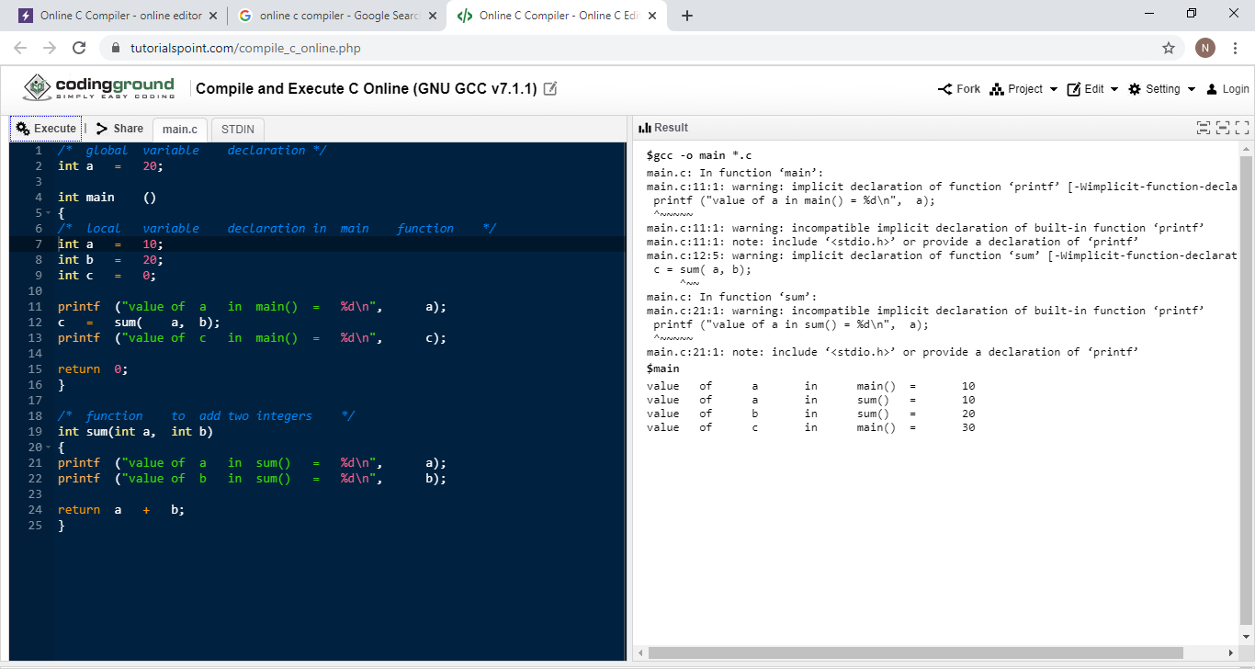

Slide 21
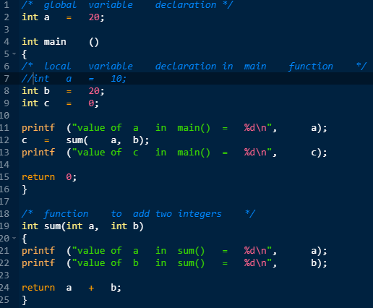


Slide 22
Functions
A special function with the name main() is the first one to run when the program starts.
All other functions are subroutines of the main() function can have any name
type name(type1 arg1, type2 arg2, ...) /* function head*/
{
/* code = function block */
}

Slide 23
Examples on function return type
int rename();
extern int rename();
void sayHello(int number_of_times)

Slide 24
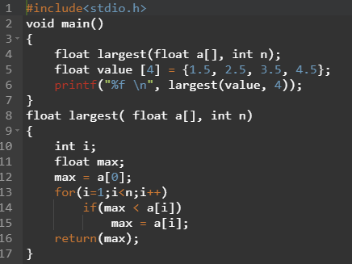
Functions using Arrays

Slide 25
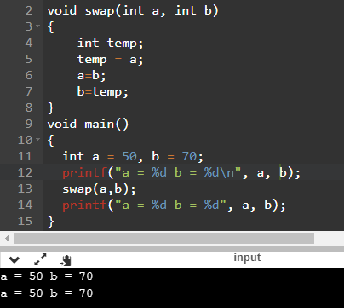
Call by Value

Slide 26
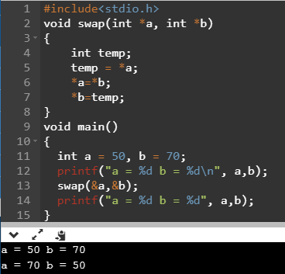
Call by Reference

Slide 27
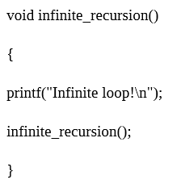
Recursion

Slide 28
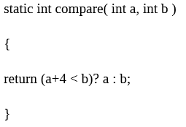
Static functions

Slide 29
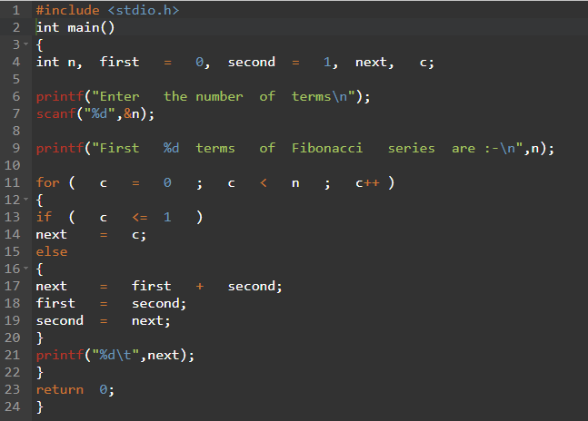
Example with different procedural approaches

Slide 30


Slide 31
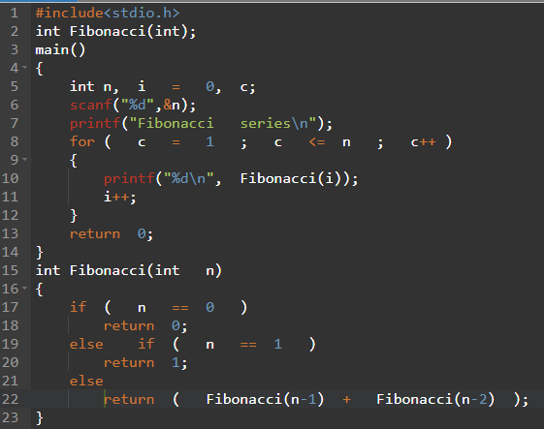
Using Recursion

Slide 32
Review of concepts in other languages
ALGOL
Functional procedures
Functional procedures are the procedures that have resulting value
Proper procedures
proper procedure do not return a value.
While both types are just called functions in C, ALGOL and some other languages distinguish these types.
In case of a proper procedure, there is no need to write void to signalize that there is no returning type. Instead, simply procedure is written without any type coming before it.
In FORTRAN and BASIC, user-defined functions are referred to as subroutines.

Slide 33
Characteristics of Procedure-Oriented Programming
Emphasis is on doing things.
Large programs are divided into smaller programs known as functions.
Most of the functions share global data.
Data move openly around the system from function to function.
Functions transform data from one form to another.
Employs top-down approach in program design.

